Slide 1
International Phonetic Symbol (IPA)

Slide 2
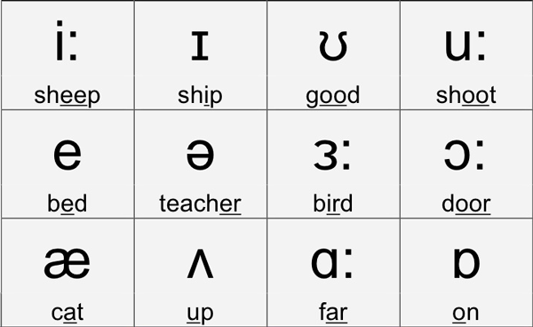
Example of Vowel symbols

Slide 3
Short Vowel
ɛ- Found in words like: bed, instead, friend Letters that usually represent it: “e,” “ea”
æ- Found in words like: cat, lad, bat Letters that usually represent it: “a”
ʌ- Found in words like: run, flood, umbrella, monday Letters that usually represent it: “u,” “o,” “oo”
ʊ- Found in words like: put, look, would Letters that usually represent it: “oo,” “oul,” “u”
ɒ- Found in words like: off, loss, cloth (General American) Letters that usually represent it: “o,” “a”
ə- Found in words like: about, the, spotted, lemon, basil, analysis Letters that usually represent it: almost any vowel
Ɪ-Found in words like: sit, hidden, amiss Letters that usually represent it: “i,” “y”

Slide 4
Long Vowel
ɪ : -Found in words like: city, see, meat, theme, fluorine, people Letters that usually represent it: “ee,” “ea,” “y,” “i”
ɜ: -Found in words like: burn, herd, earth, bird, worm Letters that usually represent it: “er,” “ear,” “ir,” “or,” “ur,” “eur”
ɔ: -Found in words like: law, caught, all, talk Letters that usually represent it: “a,” “aw,” “au,” “al”
u: -Found in words like: tube, you, choose, through, issue Letters that usually represent it: “oo,” “u,” “ou,” “ew”
ɑ: -Founds in words like: Fast, car, hard, bath.

Slide 5
Spell the word using IPA vowel symbols Short vowels long vowels ɪ sit-sɪt ɪ: see- sɪ: ʊ look-lʊk u: tube- tu:b ʌ flood-flʌd ɑ: hard-hɑ:d ɒ box-bɒx ɔ: caught-cɔ:t ə lemon-lɛmən ɜ: burn-bɜ:n ɛ bed-bɛd æ cat-cæt

Slide 6
Diphthongs
ɪə - Founds in words like: Near, ear, clear, tear, beer, fear
eə - Founds in words like: area, care, rare
eɪ - Founds in words like: Face, space, rain , case, eight
ɔɪ - Founds in words like: Joy, employ, toy, coil, oyster.
aɪ - Founds in words like: Aisle, sight, pride, kind, flight
əʊ - Founds in words like: No, don’t, stones, alone, hole
aʊ - Founds in words like: Mouth, house, brown, cow, out
ʊə - Founds in words like: Tour, poor

Slide 7
Trial triangle distribute tribe
Rule include rude pull
Sought tough thought sought
Read bead dead recede
Throw wood glue group
Wash pass bath fast
Generate kennel gentle genetics
Cleanse please treat retreat
Tough bought taught thought
Cheeseburger girl learn furniture

